Slide 1
Recommender System: Algorithms & Architecture
xiangliang@hulu.com

Slide 2

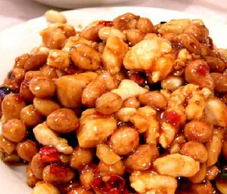
Outline
Problem
Metrics
Data
Algorithms
Cold start
Architecture
Evaluation
Recommender System

Slide 3
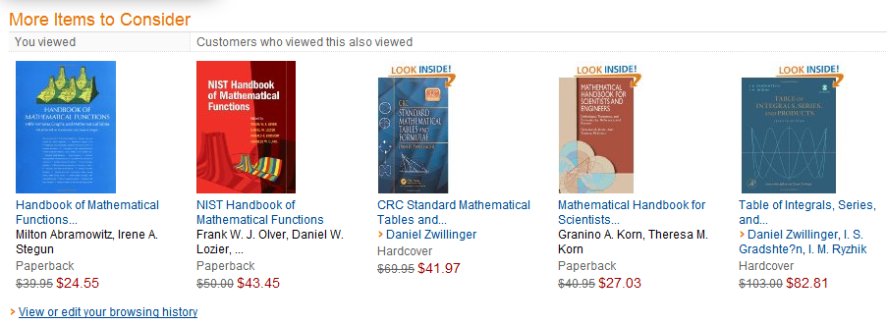
Problem
Recommend items to users to make user, content partner, websites happy!

Slide 4
Metrics
User Satisfaction
Prediction Accuracy
Coverage
Diversity
Novelty
Serendipity
Trust
Robust
Real-time

Slide 5
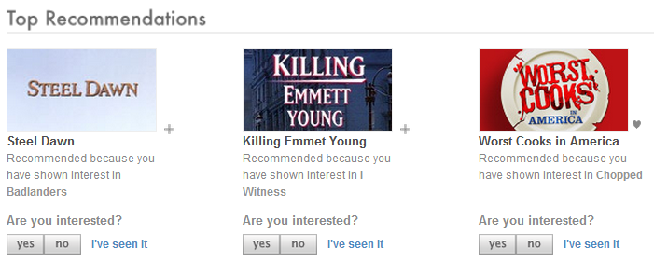
User Satisfaction
Subjective metric
Measured by user survey or online experiments

Slide 6
Prediction Accuracy
Measured by offline experiments
Top-N Recommendation
Precision / Recall
Rating Prediction
MAE, RMSE

Slide 7
Coverage
Measure the ability of recommender system to recommend all items to users.
Entropy, Gini Index
Coverage of “Most Popular” vs. “Personalized Recommendation”

Slide 8
Diversity
Measure the ability of recommender system to cover users’ different interests.
Different similarity metric generate different diversity metric.
Recommendation results should not come from single reason.
Improving recommendation lists through topic diversification [WWW2005]

Slide 9
Novelty
Measure the ability of recommender system to introduce long tail items to users.
International Workshop on Novelty and Diversity in Recommender Systems [link]
Music Recommendation and Discovery in the Long Tail [Oscar Celma]
大话西游
临岐

Slide 10
Serendipity
A recommendation result is serendipity if:
don’t have strong relation with user’s historical interest, or user do not expect we can recommend it.
novelty to user
user will find it’s interesting after user view it

Slide 11

Trust
If user trust recommender system, they will interact with it.
Ways to improve trust:
Transparency
Explanation
Social
Trust System (Epinion)

Slide 12
Robust
The ability of recommender system to prevent attack.
Examples of attack methods.
Neil Hurley. Tutorial on Robustness of Recommender System. ACM RecSys 2011.

Slide 13
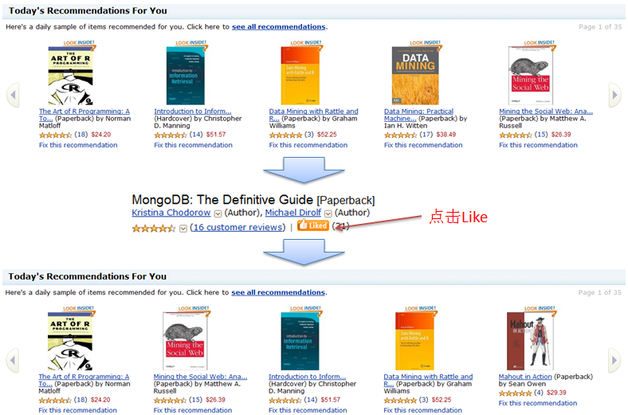
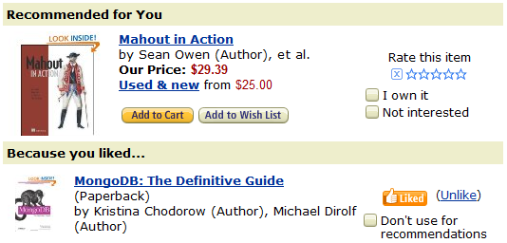
Real-time
Generate new recommendations when user have new behaviors immediately.

Slide 14
Data
User behaviors data
Behavior | User | Size
Page view | All user | Very Large
Watch video | All user | Large
Favorite | Register user | Middle
Vote | Register user | Middle
Add to playlist | Register user | Small
Facebook like | Register user | Small
Share | Register user | Small
Review | Register user | Small

Slide 15
Data
Which data is most important
Main behavior in the website
All user can have such behavior
Cost
Reflect user interests on items
Behavior | User | Size
Page view | All user | Very Large
Watch video | All user | Large
Favorite | Register user | Middle
Vote | Register user | Middle
Add to playlist | Register user | Small
Facebook like | Register user | Small
Share | Register user | Small
Review | Register user | Small

Slide 16
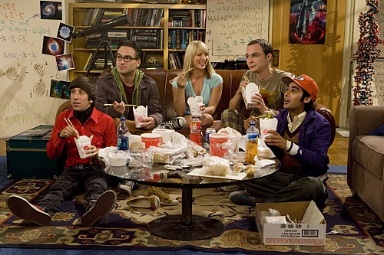
Data
Data Structure
User ID
Item ID
Behavior Type
Behavior Content
Context
Timestamp
Location
Mood
Sheldon watch Star Trek with his friends at home

Slide 17
Algorithms
Recommender System Method
Collaborative Filtering
Content Filtering
Social Filtering
……
Graph-based
Latent Factor Model
……
Neighborhood-based
……
User-based
Item-based
……

Slide 18
Neighborhood-based
User-based
Digg
Item-based
Amazon, Netflix, YouTube, Hulu, …

Slide 19
User-based
Algorithm
For user u, find a set of users S(u) have similar preference as u.
Recommend popular items among users in S(u) to user u.

Slide 20
User-based CF

Slide 21
Item-based
Algorithm
For user u, get items set N(u) this user like before.
Recommend items which are similar to many items in N(u) to user u.

Slide 22
Item-based CF

Slide 23
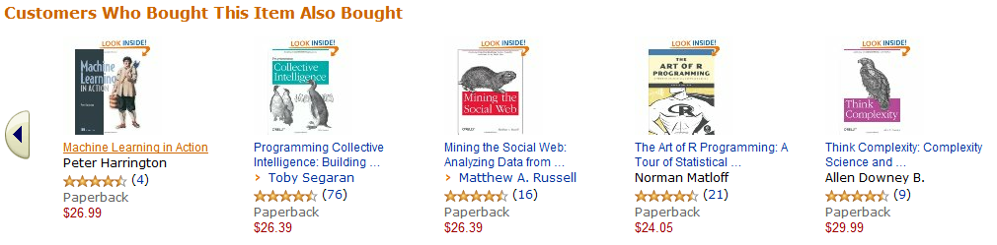
Item-based CF
Why not use
?

Slide 24
Neighborhood-based
User-based vs. Item-based
 | User-based | Item-based
Scalability | Bad when user size is large | Bad when item size is large
Explanation | Bad | Good
Novelty | Bad | Good
Coverage | Bad | Good
Cold start | Bad for new users | Bad for new items
Performance | Need to get many users history | Only need to get current user’s history

Slide 25
References
Amazon.com Recommendations item-to-item Collaborative Filtering.
Empirical Analysis of Predictive Algorithms for Collaborative Filtering.

Slide 26
Graph-based
Users’ behaviors on items can be represented by bi-part graph.
A
1
A
1
A
1
A
1
B
2
B
2
B
2
B
2
C
3
C
3
C
3
C
3
D
4
D
4
D
4
D
4

Slide 27
Graph-based
Two nodes will have high relevance if
There are many paths in graph between two nodes.
Most of paths between two nodes is short.
Most paths do not go through nodes with high out-degree.

Slide 28
Graph-based
Advantage
Heterogeneous data
Multiple user behaviors
Social Network
Context (Time, Location)
Disadvantage
Statistical-based
High cost for long path
A
1
B
2
C
3
D
4

Slide 29
References
A Graph-based Recommender System for Digital Library.
Random-walk computation of similarities between nodes of a graph with application to collaborative recommendation.

Slide 30
Latent Factor Model
Users and items are connect by latent features.
A
1
a
B
2
b
C
3
c
D
4

Slide 31

Latent Factor Model
Science Fiction
0.5
Science Fiction
0.9
Universe
0.9
Universe
0.9
Physical
0.8
Physical
0.5
Space Travel
0.8
Space Travel
0.7
Animation
0.3
Animation
0.1
Romance
0.0
Romance
0.0

Slide 32
Latent Factor Model
How to get p, q?

Slide 33
Latent Factor Model
How to define
Rating prediction
Top-N recommendation
Implicit feedback data: only have positive samples and missing values, how to select negative samples?

Slide 34
Latent Factor Model
1 (Sci-fi) | 2 (Crime) | 3 (Family) | 4 (Horror)
The invisible Man | Jaws | 101 Dalmatians | The Blair Witch Project
Frankenstein Meets the Wolf Man | Lethal Weapon | Back to the Future | Pacific Heights
Godzilla | Total Recall | Groundhog Day | Stir of Echoes
Star Wars VI | Reservoir Dogs | Tarzan | Dead Calm
The Terminator | Donnie Brasco | The Aristocats | Phantasm
Alien | The Fugitive | The Jungle Book 2 | Sleepy Hollow
Alien 2 | La shou Shen tan | Antz | The Faculty

Slide 35
Latent Factor Model
Advantage
High accuracy in rating prediction
Auto group items
Scalability is good
Learning-based
Disadvantage
Incremental updating
Real-time
Explanation

Slide 36
References
http://www.informatik.uni-trier.de/~ley/db/indices/a-tree/k/Koren:Yehuda.html

Slide 37
Cold Start
Problems
User cold start : new users
Item cold start : new items
System cold start : new systems

Slide 38
User Cold Start
How to recommend items to new users?
Non-personalization recommendation
Most popular items
Highly Rated items
Using user register profile (Age, Gender, …)

Slide 39
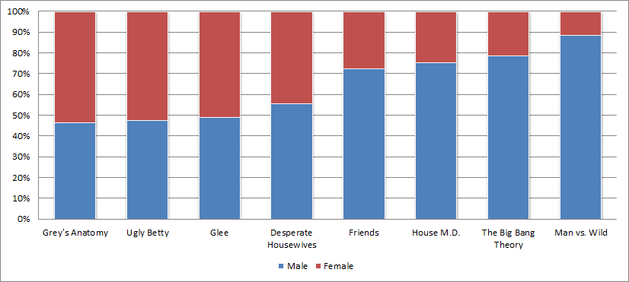
User Cold Start
Example: Gender and TV shows
Data comes from IMDB : http://www.imdb.com/title/tt0412142/ratings

Slide 40


User Cold Start
Male
Age : 20-30
Theoretical physicist
Doctor
American
Irreligious

Slide 41
How to get user interest quickly
When new user comes, his feedback on what items can help us better understand his interest?
Not very popular
Can represent a group of items
Users who like this item have different preference with users who dislike this item

Slide 42

Item Cold Start
How to recommend new items to user?
Do not recommend
How to recommend news??

Slide 43





Item Cold Start
How to recommend new items to user?
Using content information
Machine Learning
Data Mining
Recommendation

Slide 44
System Cold Start
How to design recommender system when there is no user?
Pandora : Music Genome Project
Jinni : Movie Genome Project

Slide 45
Architecture
Feature-based recommendation framework:
A
1
a
B
2
b
C
3
c
D
4
User
Feature
Item

Slide 46
Architecture
Features include:
Feature | Feature-Item Table | Algorithm
Demographic | Demographic-Item | Demographic-based
Items user like before | Item-Item Content Similarity | Item-based Content Filtering
Items user like before | User like this also like that | Item-based Collaborative Filtering
Latent Factor | Latent Factor-Item | Latent Factor Model
Users with similar preference | User-Item behaviors | User-based Collaborative Filtering
Friends | User-Item behaviors | Social-based
Tag | Tag-Item Relation | Tag-based

Slide 47







Architecture
Male
Scientist
Physics

Slide 48
User Behavior DB
Metadata DB
A
Behavior Extractor
Raw recommendation
Behavior-Feature Converter
C
Filtering
Feature
Behavior Feedback
Related Table 1
Ranking
Feature-Item Related Recommendation
Item Properties
Related Table 2
Explanation
B
Related Table N
Candidate List
Finial Recommendation

Slide 49
Architecture
Advantage:
Heterogeneous data
Reasonable Explanation
Disadvantage:
Do not support user-based methods

Slide 50
Thanks!

